Slide 1
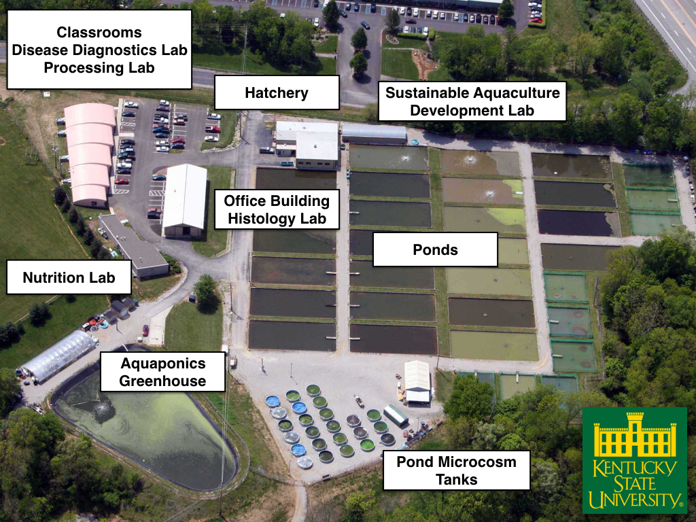
Common aquatic herbicide shows promise in fish health: A case study
John Kelso¹ and Tifani Watson¹
¹Fish Disease Diagnostic Lab (FDDL), Aquaculture Research Center (ARC), Kentucky State University Frankfort, KY 40601

Slide 2
KYSU Aquaculture Services
The fish disease lab offers fish health services free of charge.
Annual Fish Health Inspection
Fish Kill Investigation
Disease Treatment Recommendations
Aquatic weed id and management options
Water quality analysis
Aquaculture production advice
Notes:
FDDL provides fish health services free of charge for KY producers and pond owners.

Slide 3
Largemouth bass production in KY
KY produces around 150,000 lbs/year
Live-sales markets in cities (NYC, Toronto, Atlanta, others)
High value product ($7-10/lb.)
Unique challenges in transport, handling, fish health, marketing, feed costs
Nursery acquisition – AR, TX, FL, AL

Slide 4
Introduction – The problem
Record of mortality – started 100/day late July 2020
Restricted farm and lab access
Clinical signs appear
AB treatments administered
Persistent mortality
Restricted lab access lifted
10 fish sample collected
Protozoan parasites identified and treated (salt and copper sulfate)
July 2020
August 2020
September 2020

Slide 5
Lab Methods
Tank observation – Fish behaviors and clinical observations are made on the farm (stargazing, lethargy, mortality records, and management practices
Clinical work
External exam – skin and gill biopsy, wet mount preparation, microscopy
Internal exam – necropsy, bacteria swabs (kidney, spleen), observation of physical abnormalities (ascites, distention, hemorrhaging, etc.

Slide 6
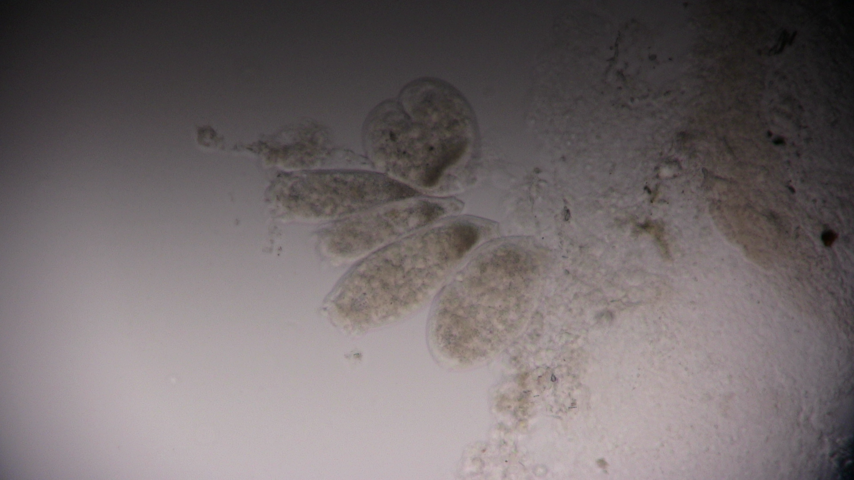
Epistylis
Notes:
Epistylis
Stalked, single celled, protists
Ecto-commensal, colonial parasite
Individual organisms secrete proteolytic enzymes to attach to calcified tissues (scale and fin rays)
Appears cottony, white mass often misidentified as fungus.
Fish health concern causes skin necrosis and stress induced mortality.

Slide 7
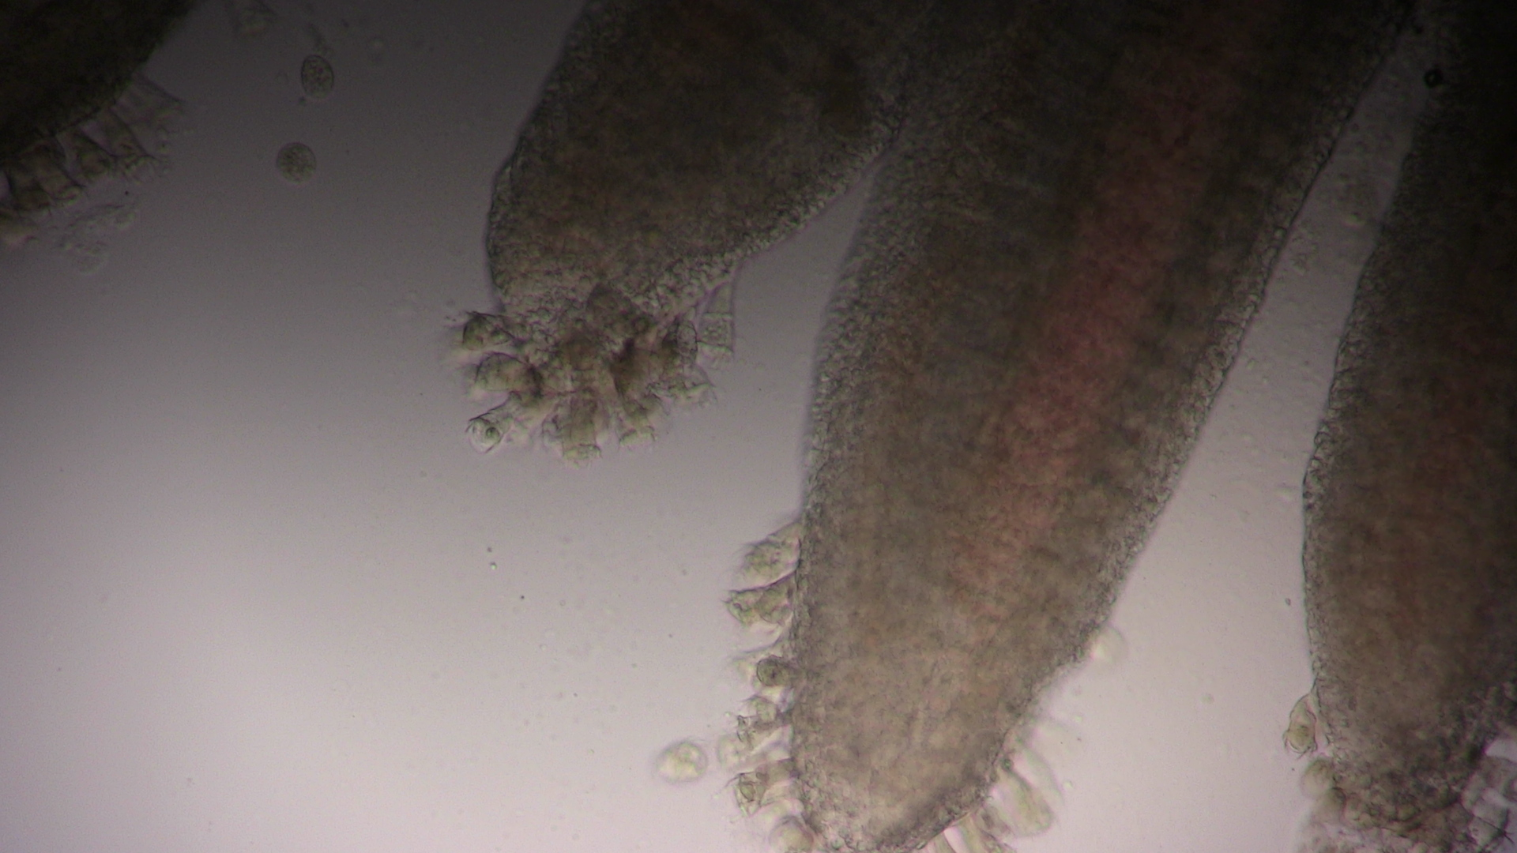
Apiosoma
Notes:
Non-motile ciliates
Elongated vase shape and triangle nucleus
Ecto-commensal, feeding or organic matter in the water column by ciliated ring around mouth parts.
Heavy infestation on the gills interferes with oxygen uptake leading to asphyxia.
Notable stress response from the fish are listness, lethargy, and piping.

Slide 8
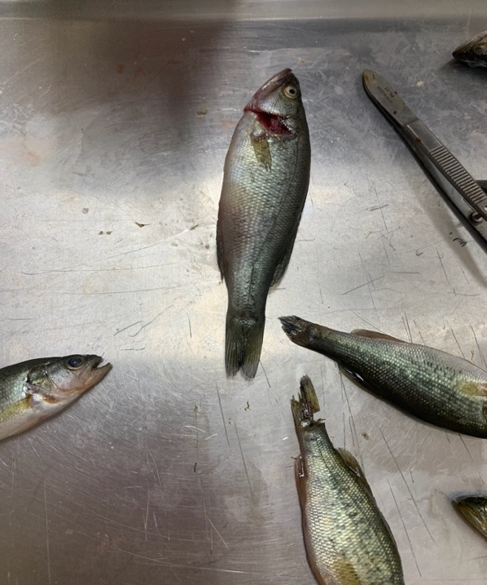
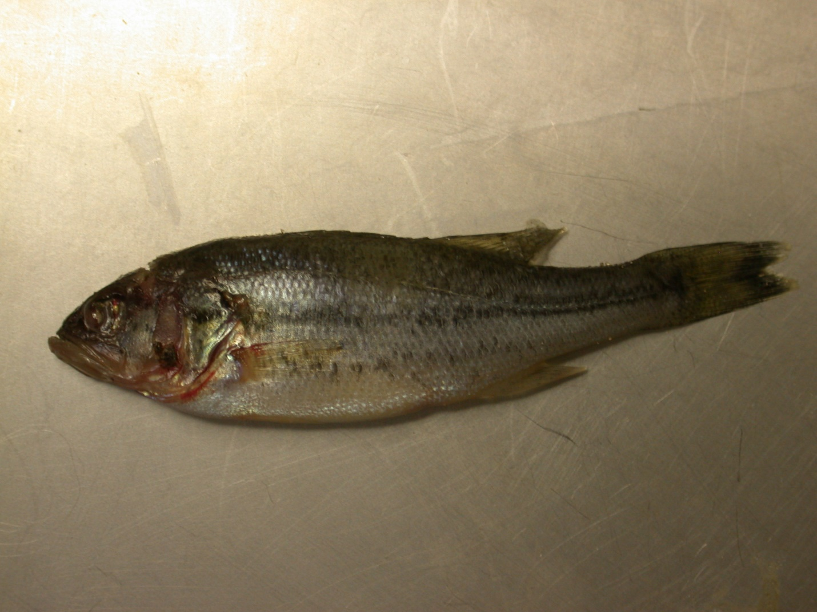
Notes:
Show here caudal fin erosion and white lesion.
Pic 2 saddleback

Slide 9
Treatments
Common treatments for external protozoan parasites are:
Copper sulfate – Total Alkalinity/100 = ppm TRT
Potassium permanganate – 2 ppm (beyond KMnO₄ demand test)
Salt – .1-3% solution (treatment time varies)
Chloramine-T, hydrogen peroxide, and formalin are also approved
Notes:
Copper – toxic to wide range of microorganisms.
Changing salinity – reduce osmoregularity difference
Reduces stress response and stimulates mucous production protecting the skin.

Slide 10
Initial treatment – September 1
Salt (4 ppt, 12 hrs, 2 consecutive days)
Copper sulfate – 4 ppm twice alternating days 12 hrs
Initially, mortality was reduced (20/day – 50%)
Signs of stress in fish (erratic swimming, piping, and stargazing) ceased
Moribund samples were collected for follow-up examination
Microscopy identified no parasites, epithelium recovering, slime coat restored.

Slide 11
What next? – Columnaris
Caused by Flavobacterium columnare (previously Flexibacter)
Clinical signs – acute mortality, “saddleback” lesion, petechial hemorrhaging, and brown slime around the mouth and gills “cigar mouth”
Colonies on the skin appear as haystacks or ant hills when viewed at 200X
Notes:
Gram negative rods colonize infected tissues. Appear as “haystacks” when viewed 200 x magnification.
Causes skin irritation, necrosis, and white lesions. Commonly causes acute mortality

Slide 13
Treatment options
Potassium permanganate, formalin, hydrogen peroxide, Chloramine-T
Diquat herbicide??
INAD experiments have shown promise in fish health with other species.
Notes:
Most common in lmb fingerling production (formalin, H2O2)

Slide 14
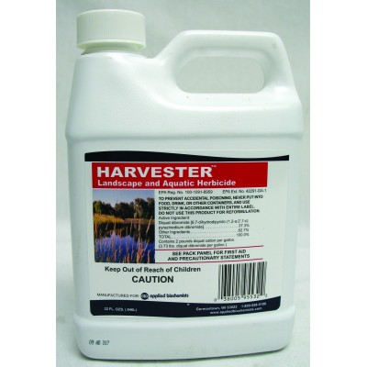
Diquat dibromide overview
Herbicide commonly used in agriculture. Interferes with photosynthesis, used in defoliation of bean and potato crops.
Approved aquatic use as a contact or systemic herbicide.
Harvester, Reward, Weedtrine-D – commonly available
37% active diquat dibromide
Notes:
3 day withdrawal for drinking water and 1 day irrigation. Breaks down quickly in the environment.

Slide 15
Diquat treatment rate
INAD – 2-18 mg/L, 1-4 hrs or 18-28 mg/L .5-1 hr. (2016)
USFWS AADAP, Iowa Dept. of Natural Resources - walleye
Previous usage at ARC is 3.4 mg/L (active ingredient) indefinite in ponds.(filamentous algae)
Treatment on farm 3.4 mg/L applied three alternating days for 8 hrs. with freshwater exchange.
Notes:
Used according to its label, there is no restriction for its use in production ponds.
Relatively non-toxic to fish.

Slide 16
Conclusions
Mortality associated with columnaris disease and protozoan parasites was drastically reduced on farm.
Fish health services rendered are a valuable asset for KY aquaculturists.
Further study of diquat dibromide as a chemical therapeutant are warranted.
Notes:
LMB toxicology studies, mechanisms of action against external bacteria, and treatment efficacy studies should continue.

Slide 17
Thank you, Questions?
John Kelso
Aquaculture Extension/Research Assistant
Kentucky State University
Aquaculture Research Center
103 Athletic Dr. Frankfort, KY 40601
john.kelso@kysu.edu

