Slide 1
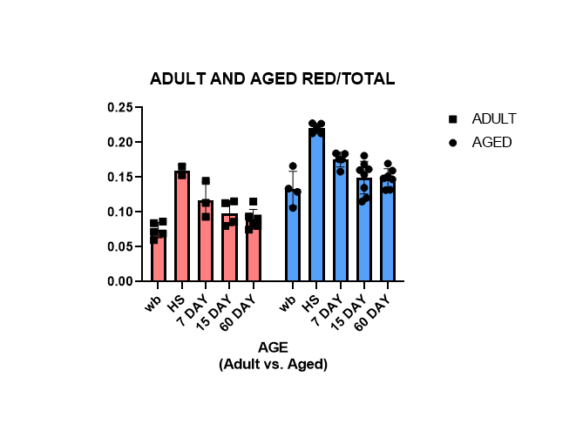
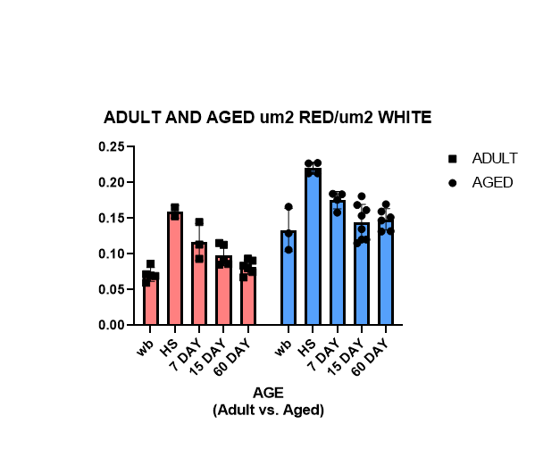
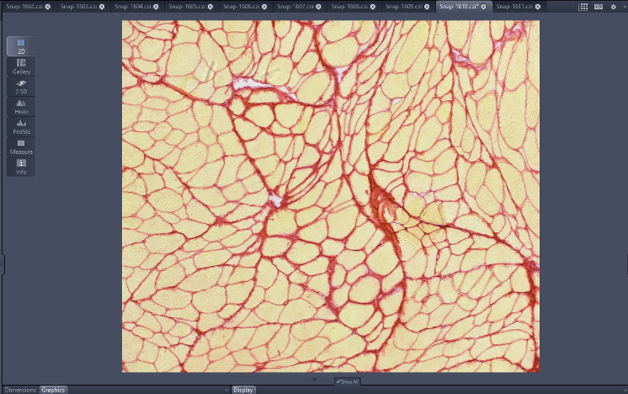
Collagen Levels Throughout Skeletal Muscle Recovery in Adult and Aged Rats
Authors: Alex Perry¹, Zach Hettinger², Amy Confides², Esther Dupont Versteegden²
1Center for Muscle Biology, University of Kentucky, Lexington KY 40536, 2Department of Biology, Georgetown College, Georgetown KY 40324
BACKGROUND
RESULTS
RESULTS CONTINUED
Sarcopenia, the loss of mass and function in skeletal muscle, can cause reduction in the quality of life- and the recovery process is thought to be slower in aged individuals.
• Previous literature determined muscle exhibits an anabolic resistance that prevents effective recovery of muscle mass and function and impairs the utility of many therapeutic interventions (Van Pelt et al, 2019).
• There is some evidence that collagen types I and III may promote muscle growth and regeneration (Duance et al, 1997).
• Collagen is the most abundant fibrous protein within the interstitial ECM (Gillies and Lieber, 2012).
Adult vs. Aged Collagen Area/Total Area
• A Two- Way ANOVA grouped analysis test compared reload times with age and analyzed total collagen area (µm2): total muscle area (µm2) and revealed a significant relationship.
• Reload time: p <0.0001
• Age: p <0.0001
•A Two- Way ANOVA grouped analysis test compared reload times with age and analyzed total collagen area (µm2): total non-collagen area (µm2) and revealed a significant relationship
• Reload time: p <0.0001
• Age: p<0.0001
Area (µm2)
OBJECTIVES
CONCLUSIONS
• Determine the relationship between sarcopenia and collagen levels in the ECM of aged vs. adult rats.
• Results of this study show collagen levels in the extracellular matrix elevation appears to remain high after hind limb suspension, and throughout the entirety of a 60-day recovery period (2,3).
- More research is needed to explore orientation of collagen type I and III fibers, and its role in skeletal muscle recovery
• Data represents clear fluctuations regarding recovery (reload) time.
• Data suggests a difference in recovery in aged and adult rats.
- More research is needed to explore this idea.
• Results of this study align with previous research concerning skeletal muscle damage and recovery.
Fig.2: Collagen levels (µm2): total area of cross section (µm2) of the gastrocnemius muscle cross sections in a healthy population (n=54) prior to (WB control) and following (post- reloading time) 7 days of hind- limb suspension. Error bars are SEM. *p<01.
METHOD
Following 7 day HLS, in comparison to total area, collagen levels remain high throughout recovery.
Population: N=51 (Male Population)
• Aged (Old) ~32 months
• Adult (Young)~10 months
Adult vs. Aged Collagen Area/ Non- Collagen Area
Experimental Reloading Variations:
(time of resumed normal mobility after suspension)
• Weight bearing (control) n=10
• 0day n=12
• 7day n=6
• 15day n=12
• 60day n=11
Area (µm2)
FUTURE DIRECTIONS
Fig. 1: Collagen staining in a cross section of gastrocnemius muscle.
• Further investigate the role of collagen fiber orientation in skeletal muscle recovery
• Explore the mechanical differences in skeletal muscle recovery in young vs. old rats
Experimental Design:
• Experimental groups hind- limb suspended for 7 days to induce muscle atrophy, and sacrificed based on reloading time
• Picrosirius red staining (Collagen I and III) on gastrocnemius muscle cross sections (PSR).
• Collagen area was compared, in ratio, with the remainder of skeletal muscle tissue (total µm-collagen), and with the total µm in the sample (constant through all samples).
REFERENCES
Fig. 3: Collagen levels (µm2): total area of non-collagen (µm2) of the gastrocnemius muscle cross sections in a healthy population (n=54) prior to (WB control) and following (post-reloading time) 7 days of hind- limb suspension. Error bars are SEM. *p<01.
1. Van Pelt, D. W., Confides, A. L., Abshire, S. M., Hunt, E. R., Dupont-Versteegden, E. E., & Butterfield, T. A. (2019). Age-related responses to a bout of mechanotherapy in skeletal muscle of Rats. Journal of Applied Physiology, 127(6), 1782–1791. https://doi.org/10.1152/japplphysiol.00641.2019
2. Duance, V. C., Restall, D. J., Beard, H., Bourne, F. J., & Bailey, A. J. (1977). The location of three collagen types in skeletal muscle. FEBS Letters, 79(2), 248–252.
3. Gillies, A. R., & Lieber, R. L. (2011). Structure and function of the skeletal muscle extracellular matrix. Muscle & Nerve, 44(3), 318–331.
Following 7 day HLS, in comparison to non- collagen areas collagen levels remain high throughout recovery.
Funding received from the American Physiological Society.

