Slide 1



Investigating the Phagocytic Role of Jedi-1 in the Meninges
Tenzin Wangmo
Sunjong Oh
Bruce D. Carter

Slide 2

ACKNOWLEDGEMENT
My Parents
Dr. Bruce D. Carter, Chris and lab members
The Aspirnaut team –
  Dr. Julie Hudson and Dr. Billy Hudson
  Coach Rachel Baugh and Ms. Irene McKirgan
  Dr. Tetyana V. Pedchenko, Dr. Elena Pokidysheva and the Hudson lab
  Dr. Susan Allison

Slide 3
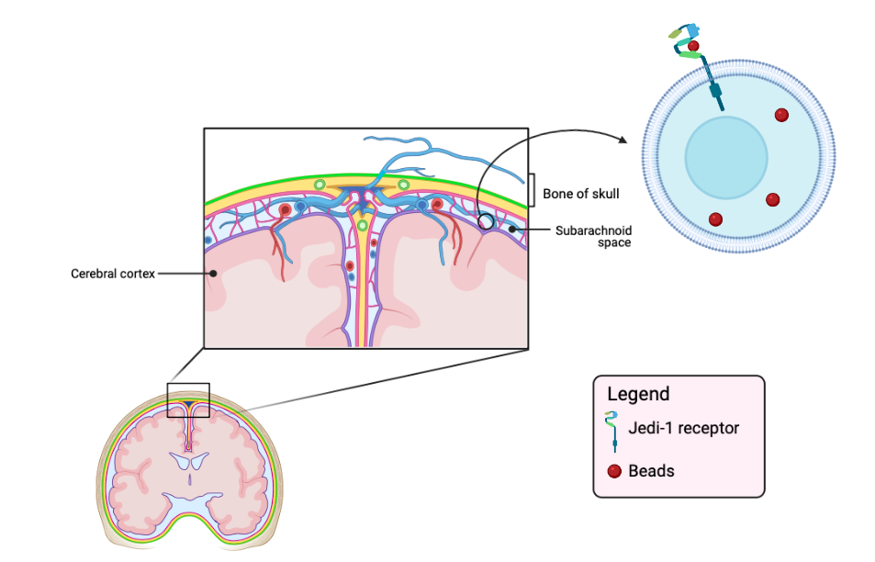
INTRODUCTION
Dura mater
Meninges
Arachnoid
Pia mater

Slide 4
HYPOTHESIS
Jedi-1 expressing arachnoid cells actively engulf beads, which mimic apoptotic cells

Slide 5
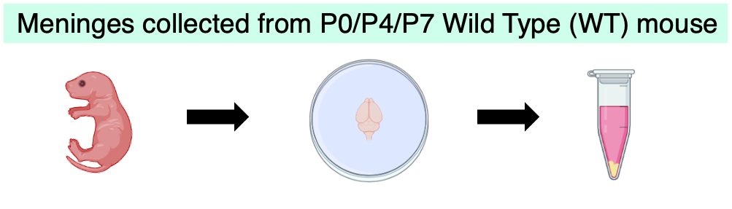
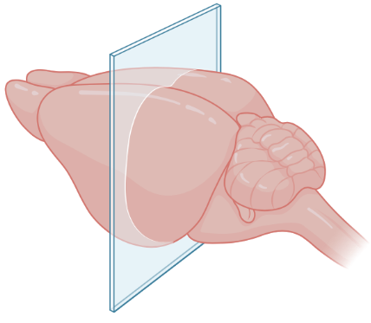



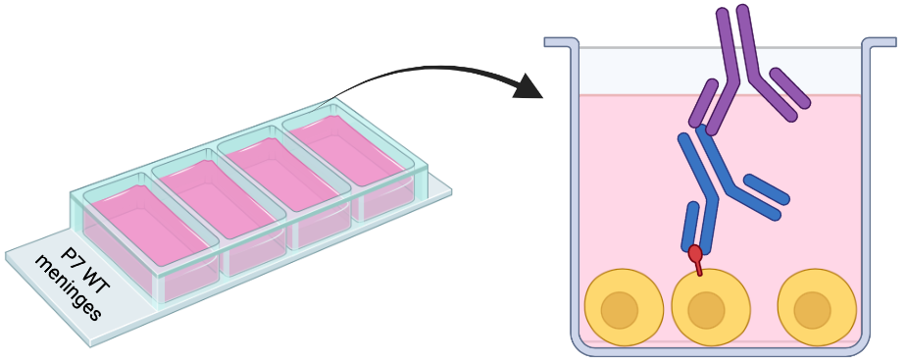
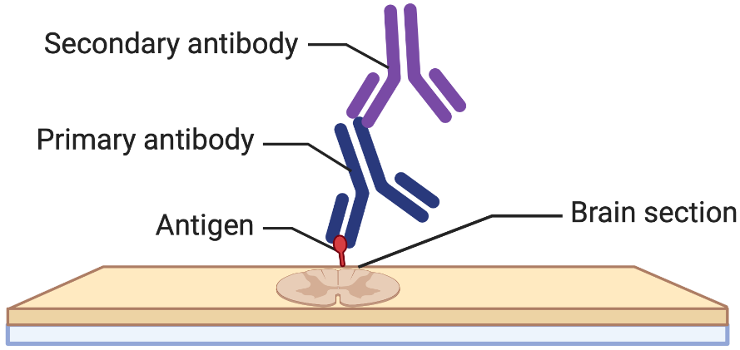



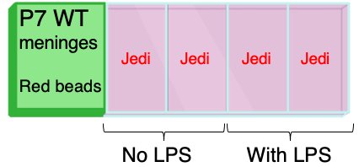

Dorsal-ventral cryosection
Immunohistochemistry
METHODS
Ladder
(kDa)
Control
Raldh
~250
P5 WT
Brain
~130
Jedi-1
~100
P75
Foxc2
~70
~55
Raldh – Arachnoid Laminin/P75 – Pia mater Foxc2 – Dura mater

Slide 6
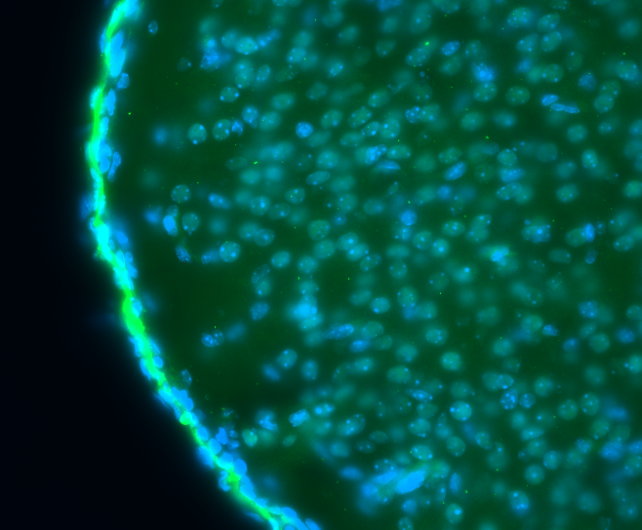
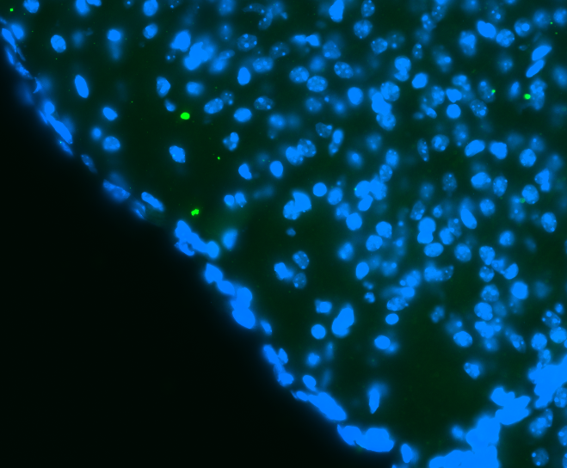
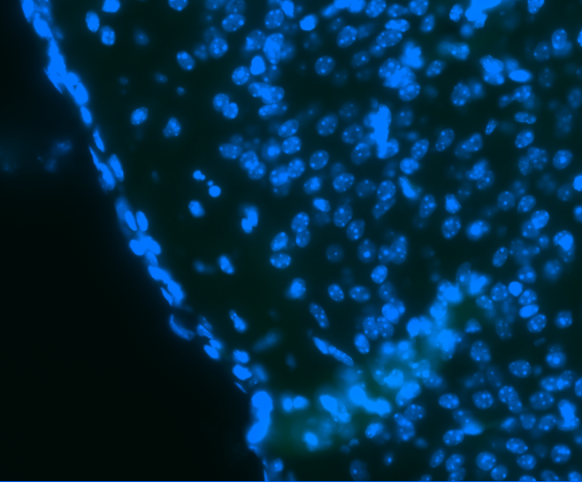
RESULTS
Immunohistochemistry – P5 mouse brain cryosection
Raldh
P75
Foxc2

Slide 7
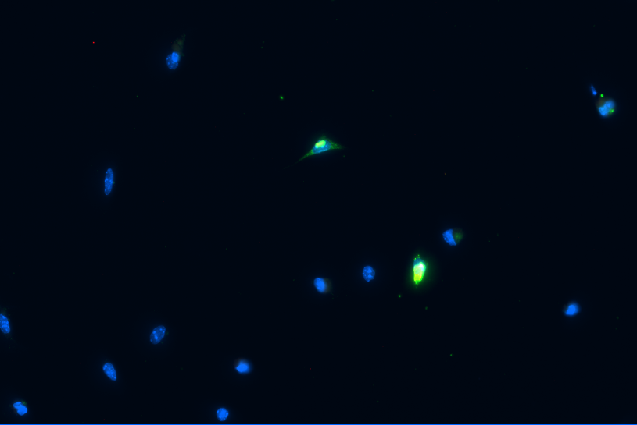
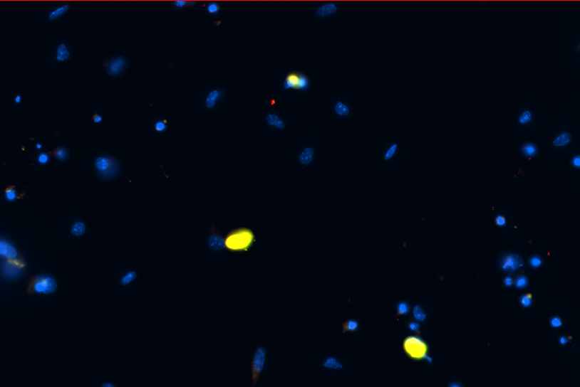
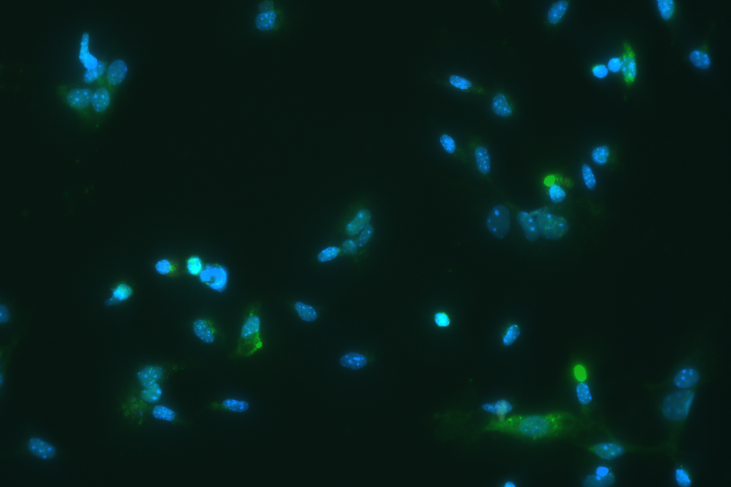
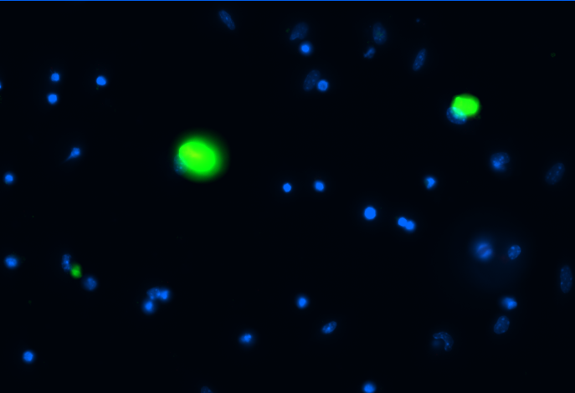
RESULTS
Immunocytochemistry – Meningeal marker + Jedi marker
ICC – Meningeal marker
Laminin + Jedi
Foxc2 + Jedi
Legend
Blue – Nuclei
Green – Meningeal marker
Red – Jedi marker
Raldh
Raldh + Jedi

Slide 8
CONCLUSION
FUTURE DIRECTIONS
Jedi protein was detected in the meninges by western blotting
Immunostaining for the meningeal markers – Laminin, P75 and Foxc2 did not work
Immunostaining for the Jedi marker did not work
Immunostaining for the arachnoid cells with Raldh did work and many of the cells in the culture were labeled
Need more optimization of the protocols
  Bead assay + Meningeal marker
  Meningeal marker + Jedi marker
  Jedi marker + bead assay
Characterize engulfed material
  TUNEL staining
  β-amyloid

Slide 9
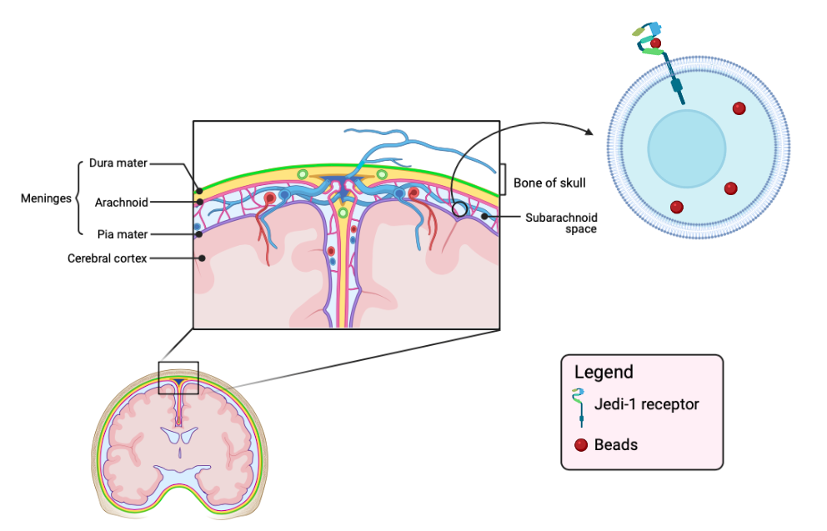
THANK YOU
Tenzin Wangmo
Email : tenzinn199@gmail.com
Contact : (859)302-4371

